Slide 1
Using the AIR Interface
TIGERRISK PARTNERS

Slide 2
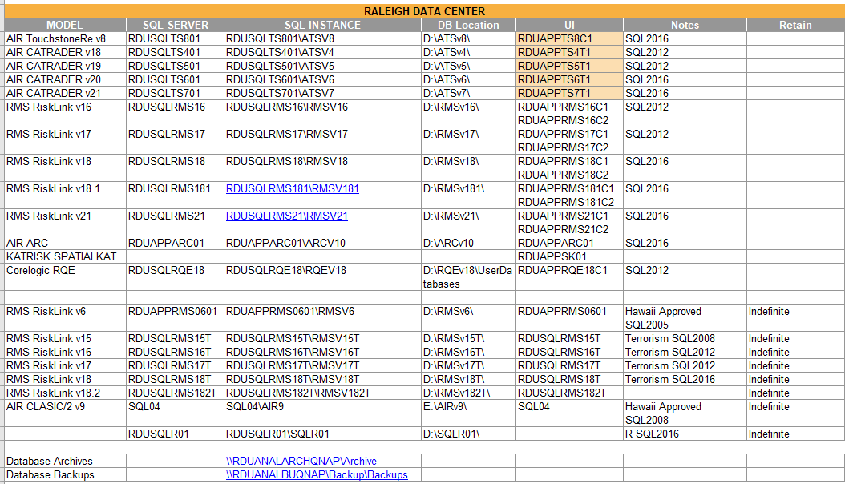
Using the AIR Interface – Getting into the Software
Log into RDU Server
Open TigerRisk.rdg
Add / Select User Interface (UI) Server
R:\01_REFERENCES
TigerRisk Modeling Servers doc
Open Touchstone

Slide 3
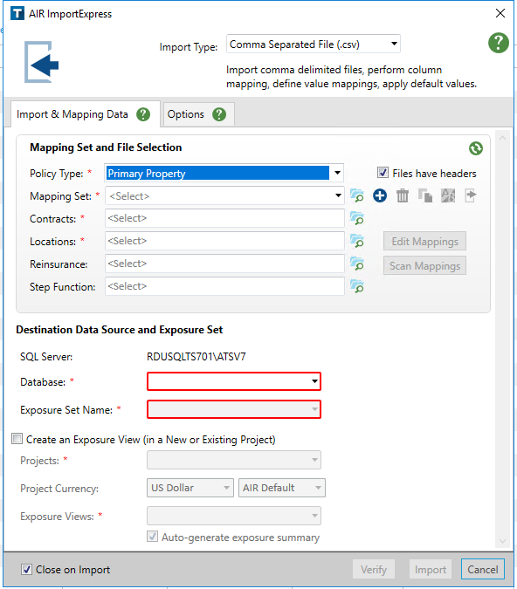
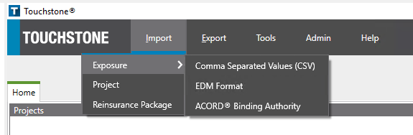
Using the AIR Interface – Importing Data
STEP 2:
STEP 1: IMPORT→EXPOSURE→CSV
Will need to assign data a mapping set to match import file headers, to AIR field headers
Select relevant Contract & Location Import Files
If a client has inuring reinsurance (reinsurance that applies to single risks, prior to catastrophe reinsurance treaties), those are applied here
Typing a new Database here is also a way to create a new Database. Databases are on located on the SQL Server.
ClientName_DataDate_CEDEvX
What kind of exposure are you importing? Hurricane? Fire Following? Severe Thunderstorm? A specific LOB?
ClientName_DataDate_Peril or Other Identifier
The “Project” is where your data will be imported and where you will view & run your exposure in the AIR interface
ClientName_DataDate
Set the same as Exposure Set Name

Slide 4
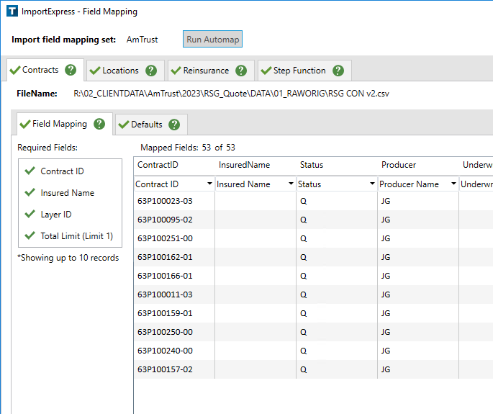
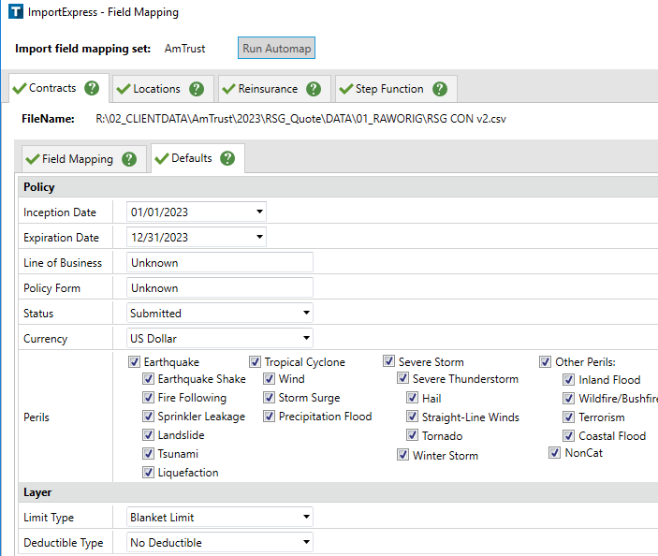
Using the AIR Interface – Importing Data
Make sure the Drop Down mappings match as intended!
If your data does not have specific information, the defaults tab outlines what the data will be mapped to by default
If storm surge is selected here, and you run your hurricane analysis with storm surge, AIR will generate 100% of the storm surge loss, no matter what percentage leakage is applied

Slide 5
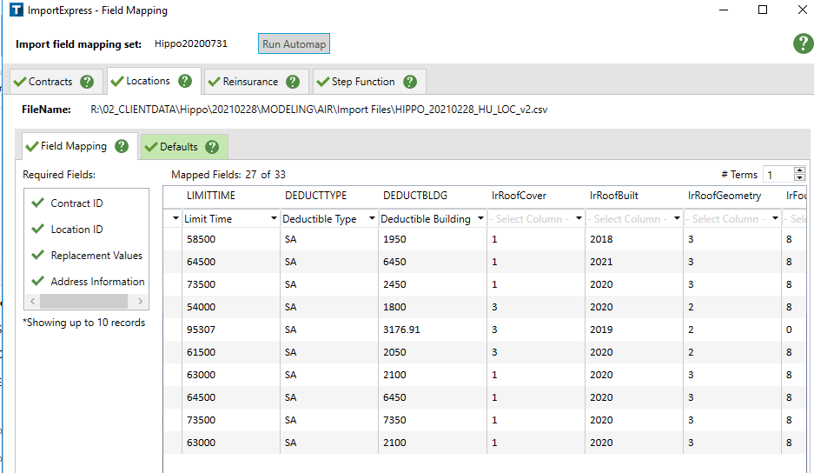
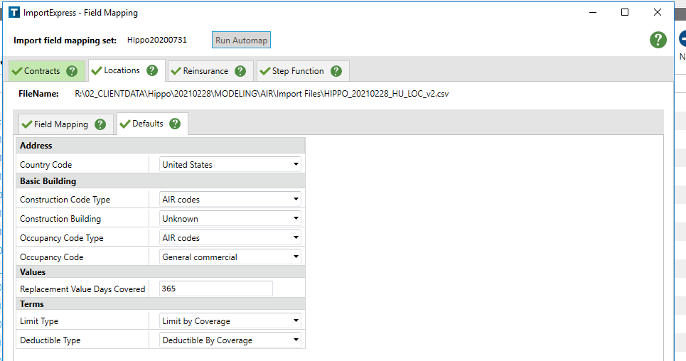
Using the AIR Interface – Importing Data
Example of fields not being mapped automatically. You need to be sure to map these correctly via the drop-down menu, otherwise if you imported it like this, these fields would not be included in the import.
If your data does not have specific information, the defaults tab outlines what the data will be mapped to by default

Slide 6
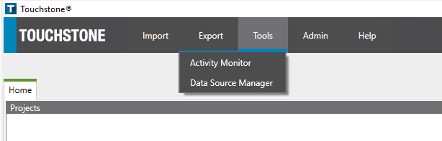
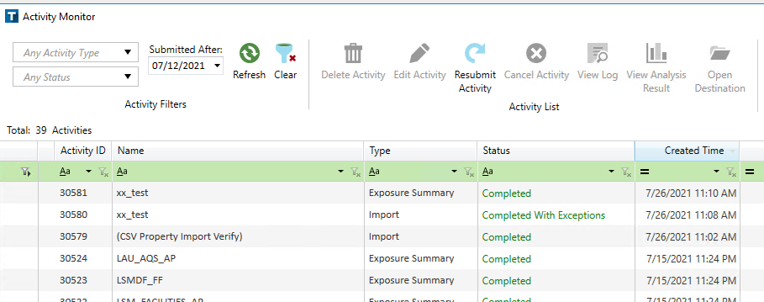
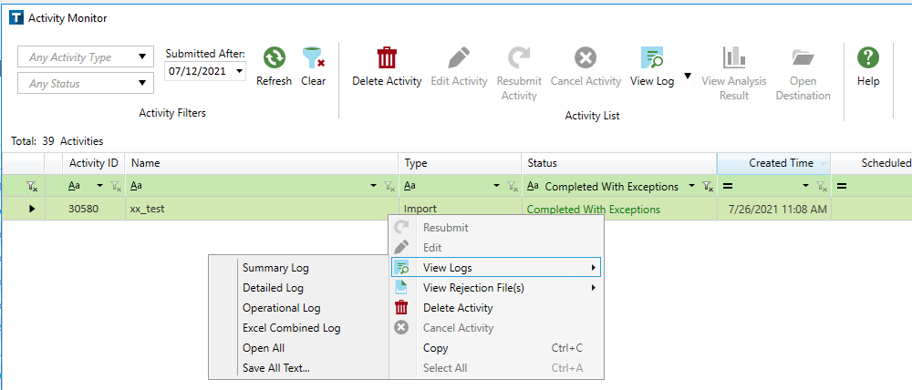
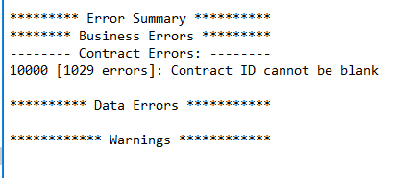
Using the AIR Interface – Importing Data
After you import your exposure, go to the activity monitor to make sure it imported successfully
If you see “Complete with Exceptions” or “Failed”, you need to check the summary log to see what the issue is. Left click on the import row (shaded)→view logs→Summary log
AIR will automatically geocode (assign a latitude/longitude to a risk) your exposure when importing. However, if you detach a database and then reattach in a newer/older AIR version – YOU SHOULD RE-GEOCODE YOUR EXPOSURE!
If you scroll to the bottom of the summary log, it will have an error summary where you can figure out why your exposure is having import errors and can fix accordingly.

Slide 7
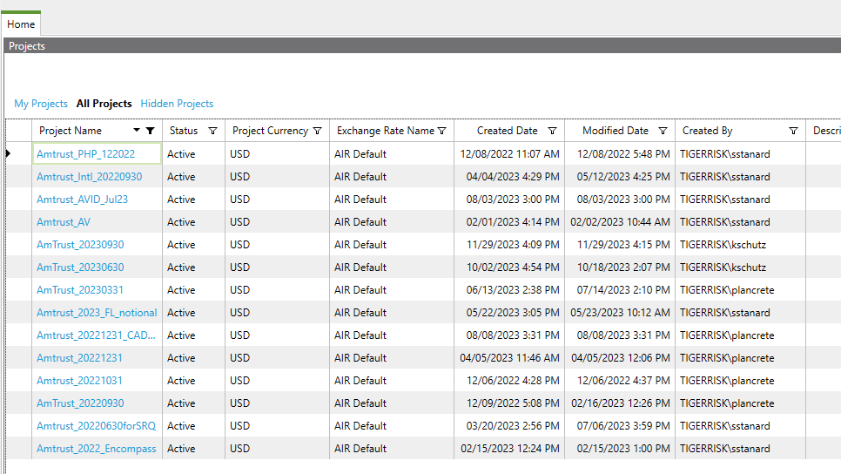
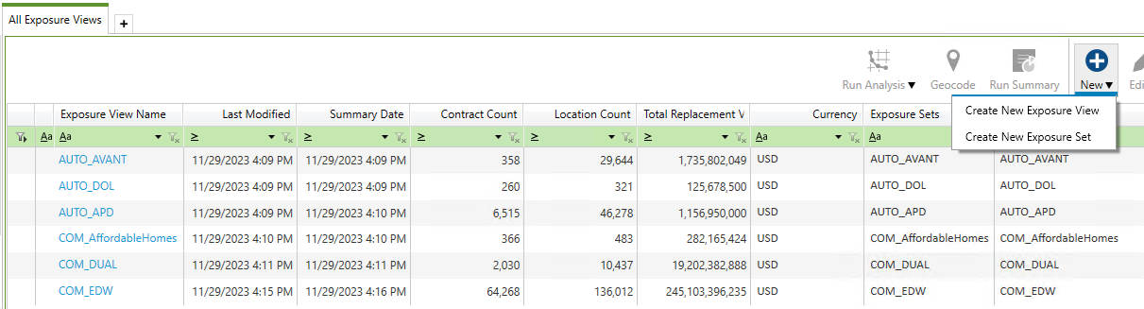
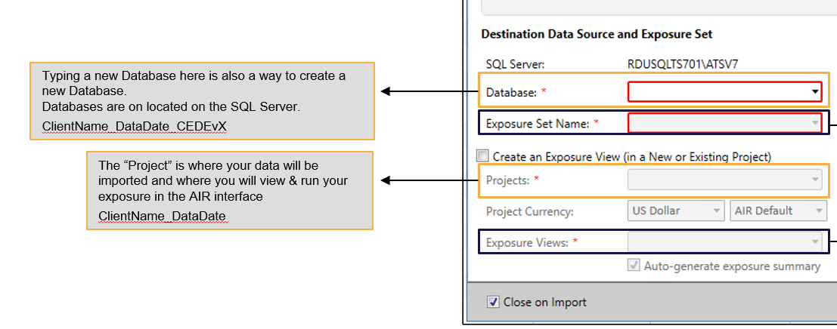
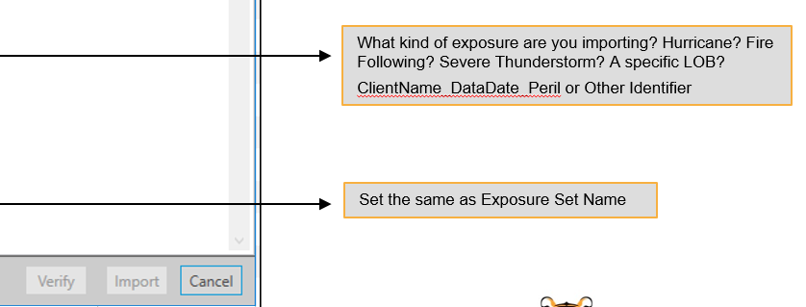
Using the AIR Interface – Exposure Sets & Exposure Views
An exposure set will be your imported exposure in totality and Exposure sets are accessible in the SQL background tables. An exposure view can represent your exposure in totality (aka your exposure set), or it can be a subset of your exposure set, or multiple exposure sets combined. Exposure Views cannot be viewed in SQL automatically after generating them.
Find project (you named this when importing your exposure) – this is where your exposure is housed

Slide 8
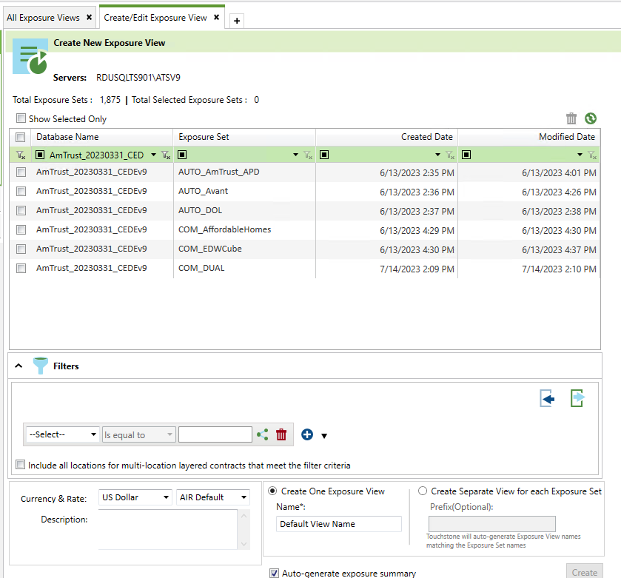
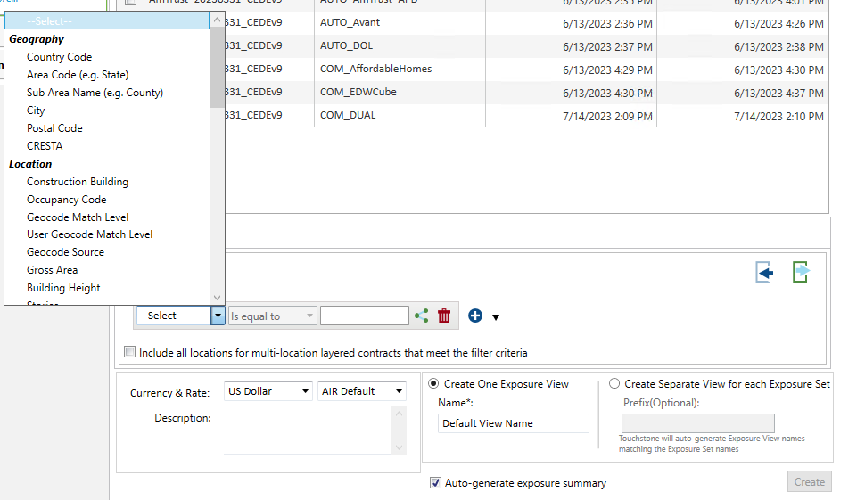
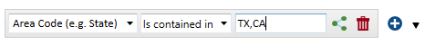
Using the AIR Interface – Creating Exposure Views
Select the CEDE database & the exposure sets that you are trying to filter or combine to create a new exposure view
What exposure view are you trying to create? Or how are you trying to filter your exposure set?
By State?
By Geocode resolution?
By Line of Business?
Note when filtering, you do not need to have quotation marks, apostrophes, or parentheses – see below example of filtering on TX & CA risks only.
If you are creating a view from multiple exposure sets, and want just one single consolidated exposure view, select this (and rename it to something other than ‘Default View Name”)

Slide 9
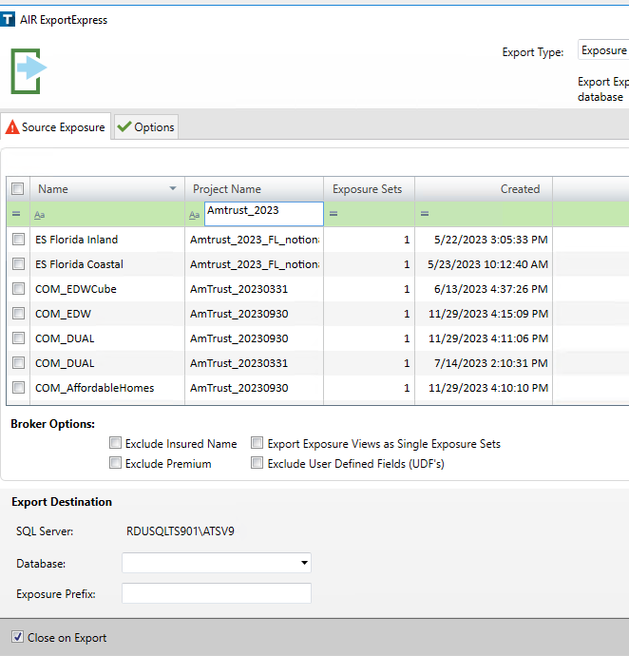
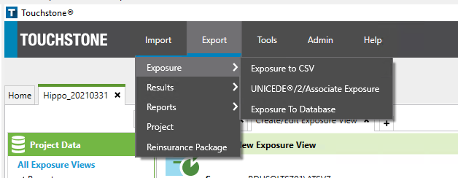
Using the AIR Interface – Creating Exposure Sets & Views
If you want to be able to look at an Exposure View you created in SQL, or provide the view to markets, you will need to export that Exposure View into a CEDE database.
Select Project that you created your new Exposure view in, then select the new Exposure view.
Where do you want to send your exposure view? You can create a new CEDE database and send it there here as well
If you’re exposure view is based on multiple exposure sets and is consolidated into a single exposure view, you will need to select this in order to maintain that consolidated view.

Slide 10
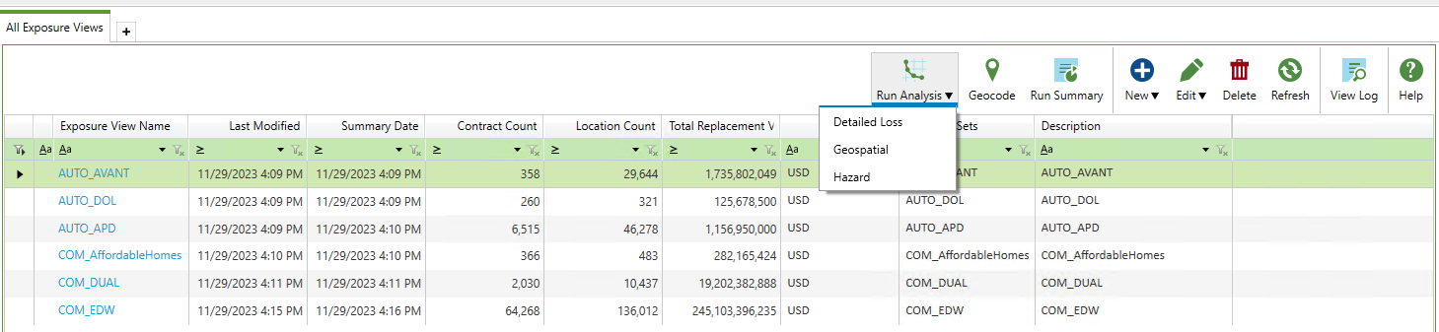
Using the AIR Interface – Running an Analysis
Select Exposure View you’d like to Run
WHAT KIND OF ANALYSIS DO YOU WANT TO RUN?
Detailed Loss: Most common analysis you’ll run – this will run a 10K, 50K, or 100K year simulation and we are able to pull together a YELT (Year, Event ID, Modeled Loss) from these.
Hazard: Will give you hazard information for risks within your exposure – but will not generate any modeled losses. For example, some of the details it will provide are:
Distance to coast (relevant for Hurricane)
Elevation (relevant for Hurricane)
Soil Type (relevant for Earthquake)
Distance to nearest Fault (relevant for Earthquake)
FEMA Flood Zone (relevant for Flood)

Slide 11
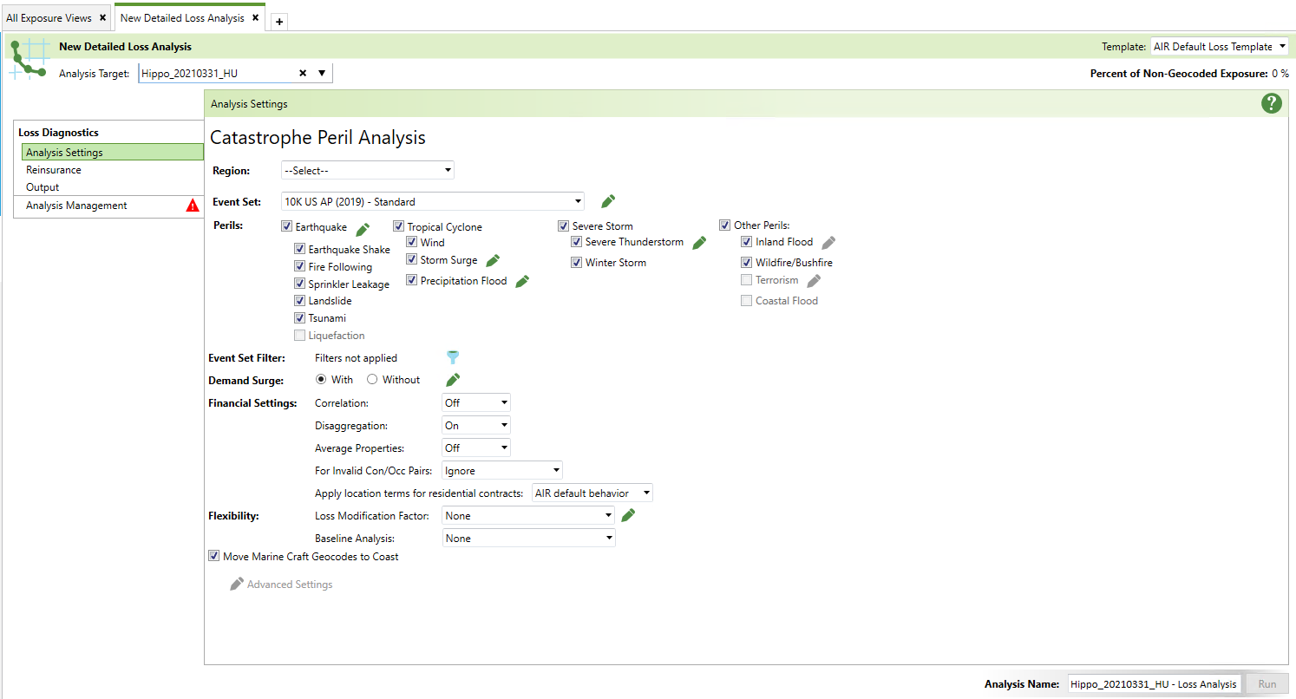
Using the AIR Interface – Running a Detailed Loss Analysis
Exposure View you are running the models against (can run more than 1 exposure view at a time)
What Perils (and sub perils) are you running your exposure against? You likely will only run certain perils against exposure sets given Hurricane exposure often has different deductibles than other perils.
What model are you running your exposure against? This Event Set selection dictates three important factors:
Number of Years of Simulation (the standard is 10K)
Region (US vs World Exposure)
Model View for HU or EQ
WSST (Conditioned on Warm Sea Surface Temperatures)
Standard (based on Historical Record / accounts for EQ activity along faults)
Time Independent (doesn’t take into account when the last EQ was)
Default AIR settings. Will most likely leave these at their default views when running analyses.
Name Analysis Run – ie. Hippo_20210331_HU - LTwDS

Slide 12
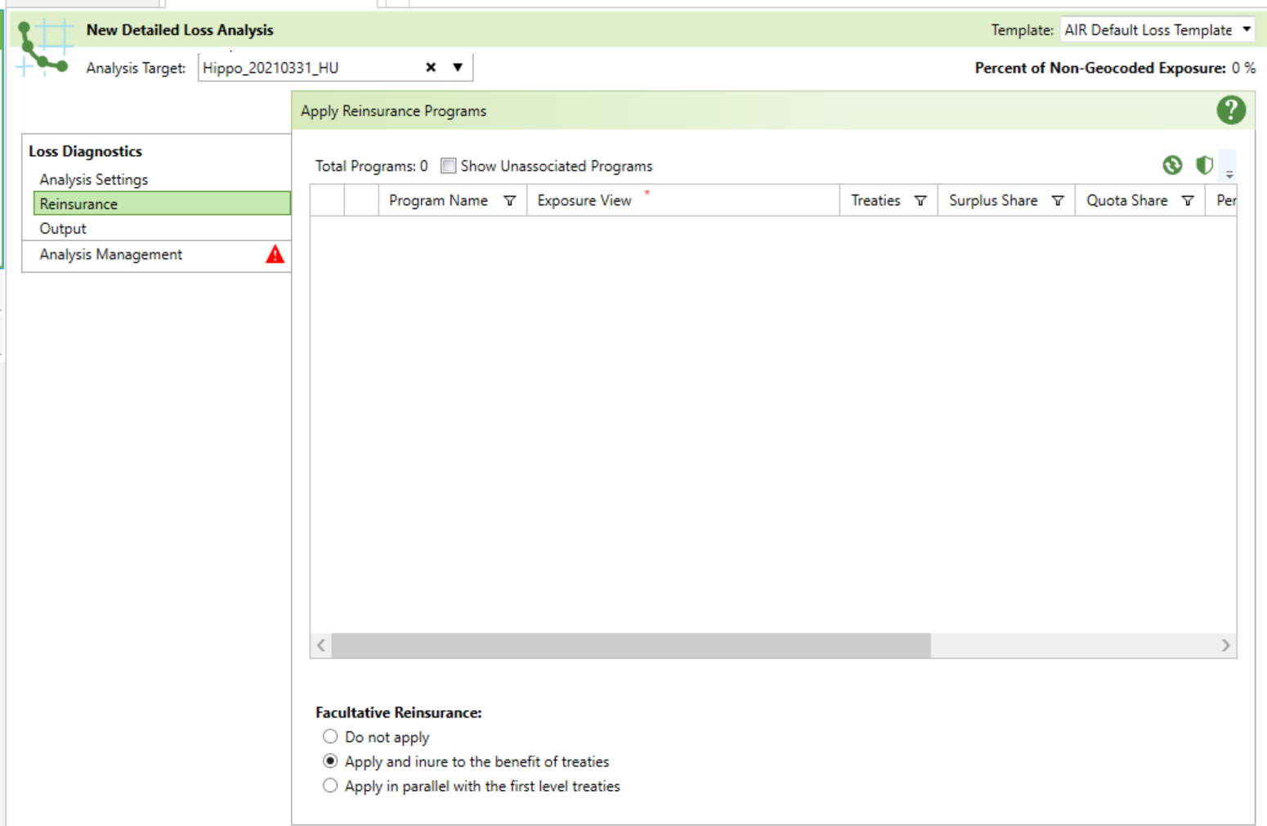
Using the AIR Interface – Running a Detailed Loss Analysis
If treaty reinsurance applies (reinsurance for a specific group of risks, prior to the application of any catastrophe reinsurance), on this tab is where you would apply them
By default, AIR applies facultative reinsurance first, so they inure to the benefit of other applicable treaty reinsurance

Slide 13
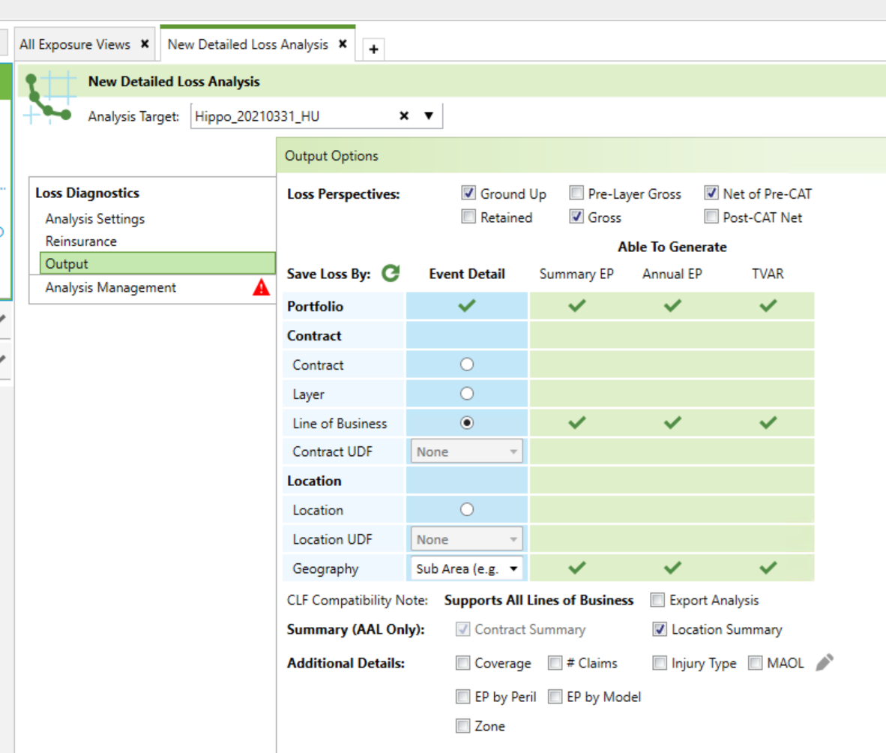
Using the AIR Interface – Running a Detailed Loss Analysis
What perspective do you want to see your losses in? You can run all of them if you’d wish (but the more you select, the longer your analysis will take to run). Standard is to run Ground Up, Gross, and Net of Pre-Cat views. Ground Up – Total Event Loss without application of any insurance or reinsurance terms
Retained – Represents the amount the policyholder is responsible for
Gross – Represents loss after the application of policy terms (deductibles and limits)
Net of Pre-Cat – Represents loss net of primary policy terms, and any reinsurance recoveries
Post-Cat Net – Represents loss net of Catastrophe XOL treaty to Net of Pre-Cat Losses
At what granularity do you want to compile your YELT (Year-Event-Loss-Table)? Note you can run multiple levels at once.
Line of Business?
Location Level?
UserID level?
Geography (I.e. State, County level)?
Most common: by Line of Business by County – if you need to provide results to reinsurers, you will NEED to run your exposure at this level (this is a CLF compatible level)
Selecting this will give you a location level AAL. This is the summation of losses from ALL events impacting a particular location, divided by the number of years of simulation. However, you will not be able to see the event level location losses when selecting this! In order to see event level losses at the location level, you would need to select the location level event detail (red circle)

Slide 14
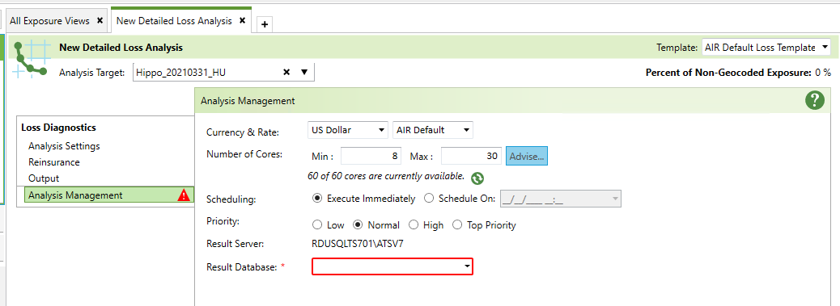
Using the AIR Interface – Running a Detailed Loss Analysis
Where do you want to send your loss analysis? Note you can also create a new Loss database here.
ClientName_DataDate_LOSSvX
If your run is urgent, you can send to “Top Priority”, and if there is a queue of analyses, AIR will prioritize your run.

Slide 15
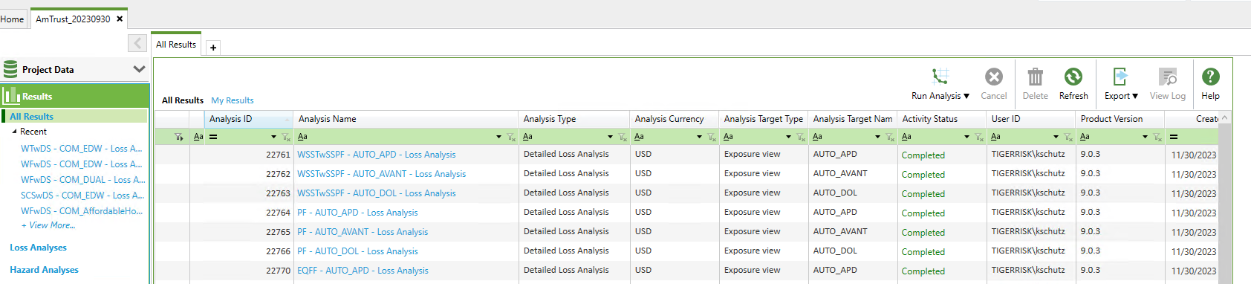
Using the AIR Interface – Viewing Results in the AIR Interface
Here are all of the analysis runs you ran within your project

Slide 16
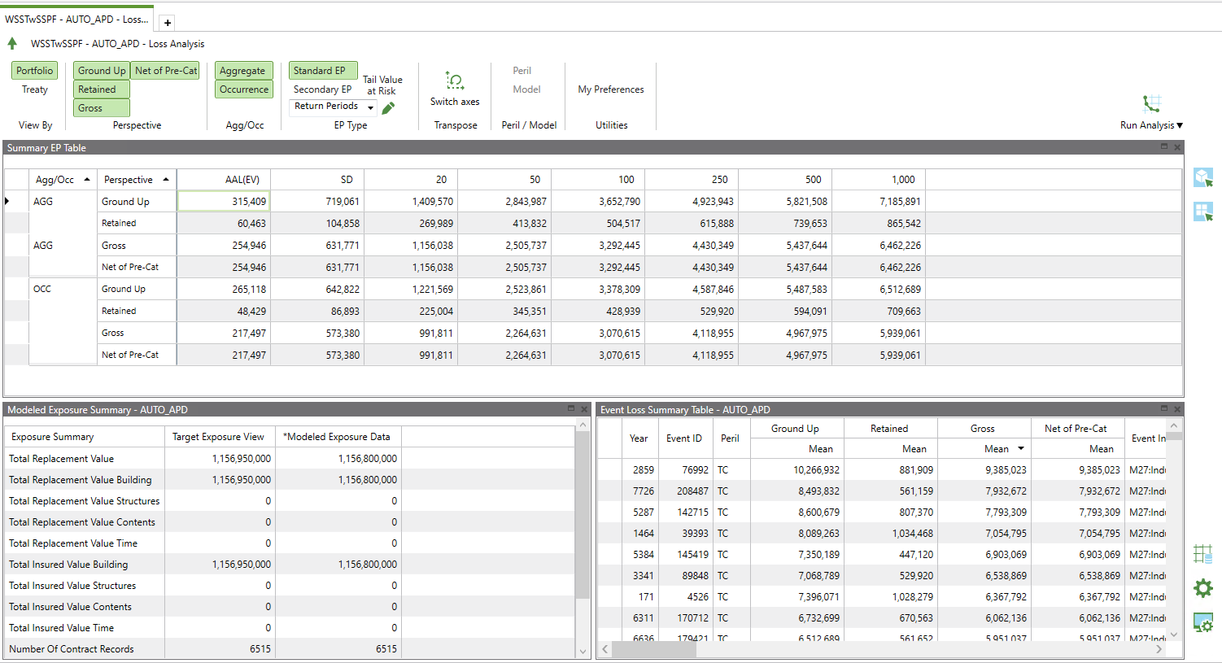
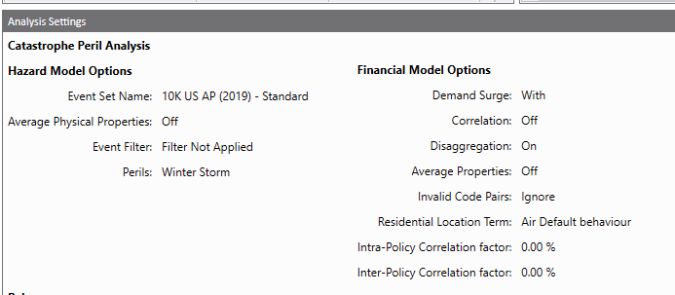
Using the AIR Interface – Viewing Results in the AIR Interface
You can adjust the PML settings that are displayed in the table below
Here are the PML Summaries (based on the settings you selected above). When you import your YELT into TigerEye, you should make sure your PMLs tie to what is shown here in the AIR interface
Selecting this will give you the analysis settings of this model run (what event set you ran, was demand surge included, etc.)
Can add return periods by selecting this

Slide 17
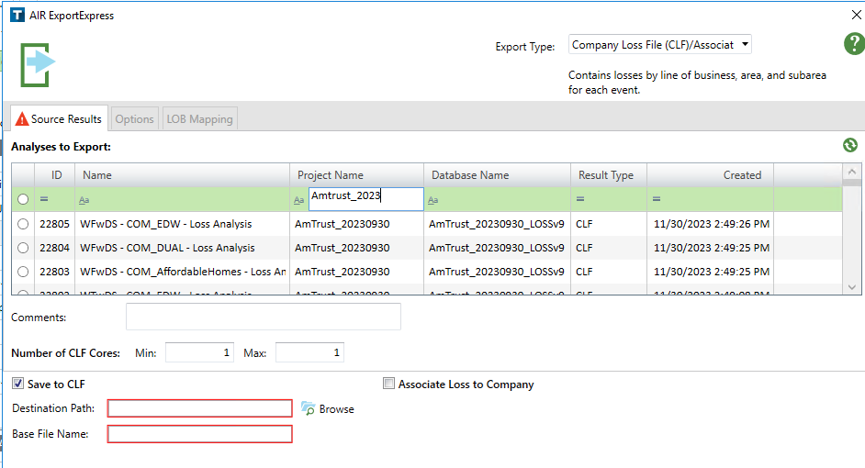
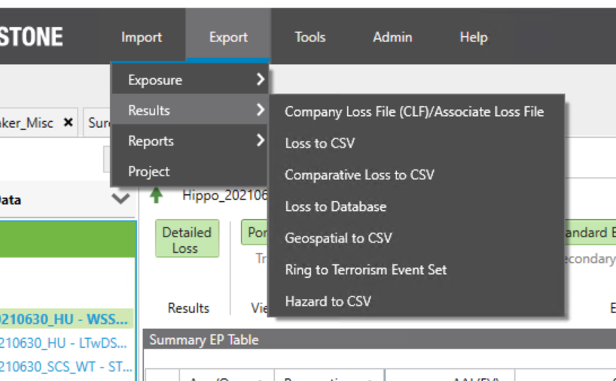
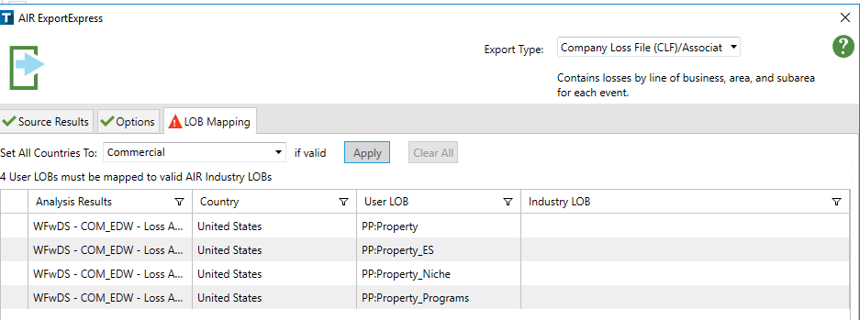
Using the AIR Interface – Exporting Results for Market
Select your analysis (can only select one analysis at a time)
Where do you want to send the CLF to?
A CLF is called a ‘Company Loss File’ and contains losses by county by LOB. This is the format that AIR losses are provided in because this format can be imported into Catrader or Touchstone Re, which is what many markets use to apply modeled losses against reinsurance structures.
Need to identify what kind of exposure it is that you ran & then click “apply”

Slide 18
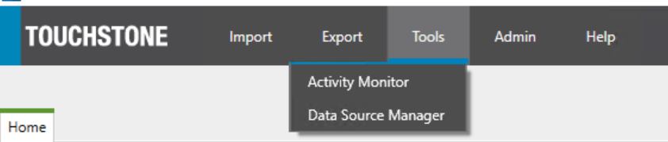
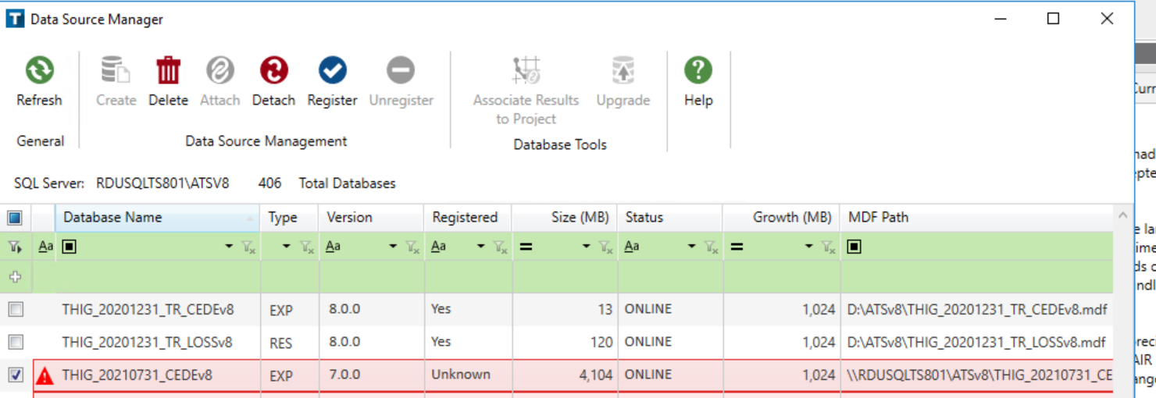
Using the AIR Interface – Registering Databases
If you receive CEDE databases from clients, you can attach the CEDE database in SQL and then do the following in the AIR interface:
Go to Tools – Data Source Manager
Select the Database you just attached in SQL (should be highlighted in red below)
Register!

Slide 19


Slide 20
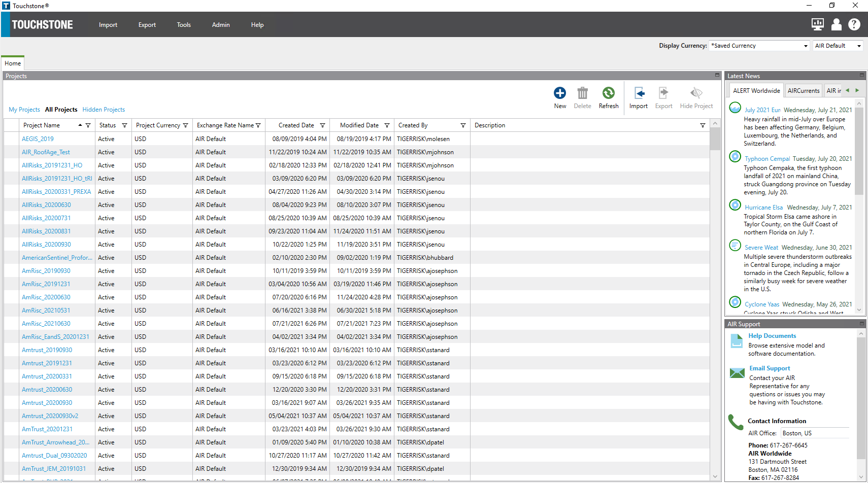
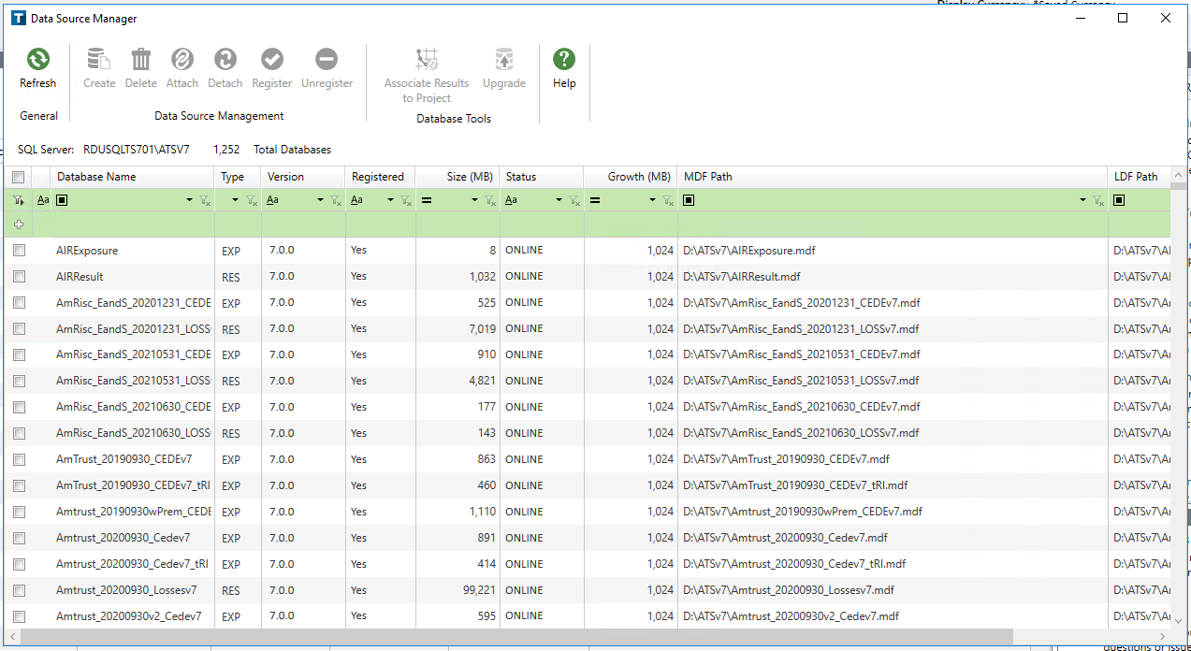
Using the AIR Interface – Creating a Database
CEDE Database: Holds Exposure & Policy Term Information
LOSS Database: Holds Modeled Loss Information
DATA SOURCE MANAGER
Type database you’d like to create here:
ClientName_Date_CEDEvX ClientName_Date_LOSSvX
After typing database, must select this!
WHEN WOULD YOU WANT TO CREATE A DATABASE?
In order to import data into the software, or generate modeled losses, we need a database to send this data into
Can also create CEDE / Loss databases during import process and through running an analysis - BEST PRACTICE
If we receive data in a more recent SQL version than what we have installed, will have to create a blank database, and then transfer data

Slide 21
Using the AIR Interface – Editing Exposure
You may need to edit your exposure for certain client work. Example scenarios:
For Demotech, you need to run your exposure without secondary modifiers
You’re given Latitude / Longitude detail after you’ve imported the data already
Steps to complete this working within AIR interface & SQL:
Export the exposure you want to edit to a CEDE database – THIS CREATES A NEW EXPOSURE SET
Make edits in SQL to that newly created exposure set within the CEDE database you sent it to
Back in the AIR Interface within your project, add a new exposure view (and then select your newly created exposure set that you made edits to)
Run the new exposure view!
You could also simply re-import the exposure based on the edits that need to be made

